Slide 1
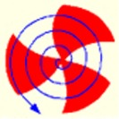
Interference of thermal photons from quark and hadronic phases in relativistic collisions of heavy nuclei
Dinesh K. Srivastava
Variable Energy cyclotron Centre, Kolkata
In collaboration with Rupa Chatterjee

Slide 2
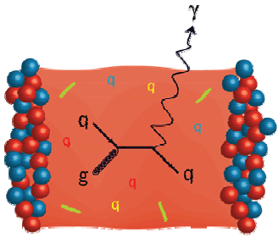

Direct photons are penetrating probes for the bulk matter produced in nuclear collisions, as they do not interact strongly. They have a large mean free path.
In-medium photon self energy:
Directly related to the in-medium vector spectral densities!
freeze-out surface
t
Penetrating probes: emitted at all stages
then survive unscathed ( α_{e}<< α_{s}).
“Historians” of the heavy ion collision:
encode all sub-processes at all times
qgp phase
hadronic phase
pre-equilibrium
phase
mixed phase
z

Slide 3
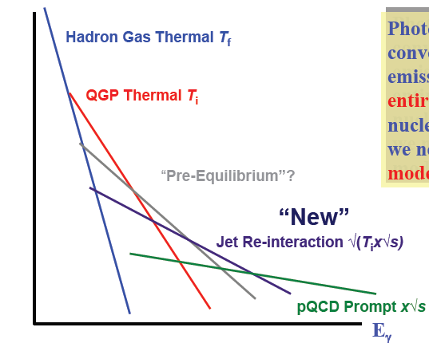
Direct Photons
Different Sources – Different Slopes
Rate
Photons are result of convolutions of the emissions from the entire history of the nuclear collision, so we need rates and a model for evolution.
Hydrodynamics.
Cascades.
Fire-balls.
Cascade+Hydro..

Slide 4
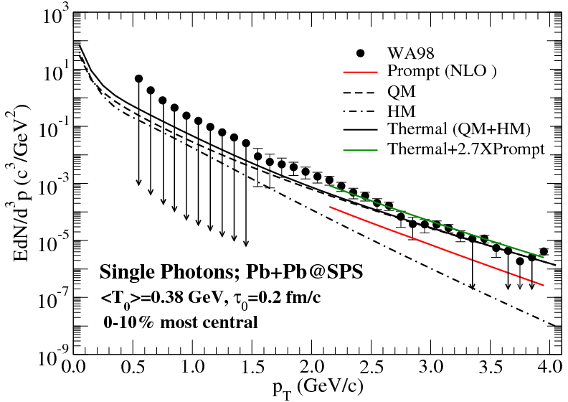
Complete O(α_{S}) for QGP &
Exhaustive Hadronic Reactions for hadrons
DKS, PRC 71 (2005) 034905.
Chatterjee, DKS, & Jeon;
PRC 79 (2009) 034906.
Hydrodynamics, QGP + rich EOS for hadrons
& accounting for the prompt photons

Slide 5
Thermal Photons from Au+Au@RHIC
d’Enterria & Peressounko,
EPJC 46 (2006) 451.

Slide 6
Photons from Passage of Jets through QGP
Fries, Mueller, & DKS, PRL 90 (2003) 132301.
The “bremsstrahlung” contribution will be suppressed due to E-loss.

Slide 7
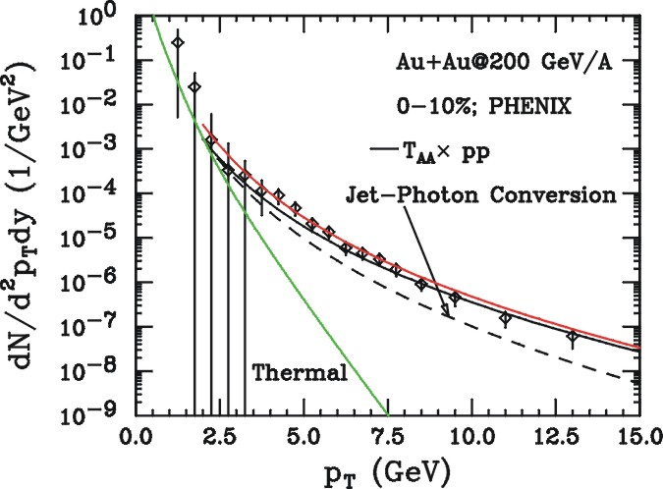
FMS Results: Comparison to Data
for p_{T} < 6 GeV, FMS photons give significant
contribution to photon spectrum: 50% @ 4 GeV.
Fries, Mueller, & DKS, PRC 72 (2005) 041902( R).

Slide 8
k₁
r₁
x₁
ΔR
Quantum statistical correlation
r₂
k₂
x₂
Identical point sources at positions r₁ and r₂.
Single particle momentum distribution:
Two particle momentum distribution:
Two particle correlation:

Slide 9
k₁
q
q_{side}
k₂
q_{out}
q_{long}

Slide 10
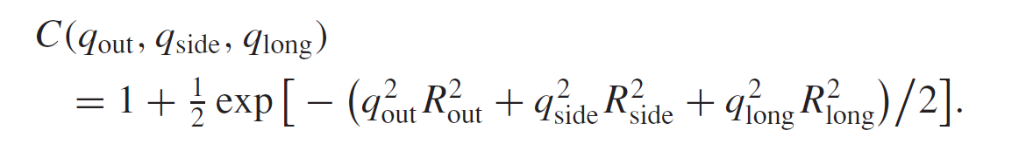
R_{long}
k₁
q
q_{side}
R_{side}
k₂
q_{out}
R_{out}
q_{long}
The corresponding radii are obtained by approximating C as:
R_{i}²= 1/<q_{i}²>, where i = out, side, and long, and the average is performed over the distribution (C − 1).
One can show that R_{out} – R_{side} is a measure of the duration of the emission.

Slide 11
Chronology of intensity correlation experiments
relativistic energies
intermediate energies
ππ
pp
hadronic
γγ
γγ
γγ
electromagnetic
astronomy
intermediate energies
relativistic energies
1950
1960
1980
1994
2004

Slide 12
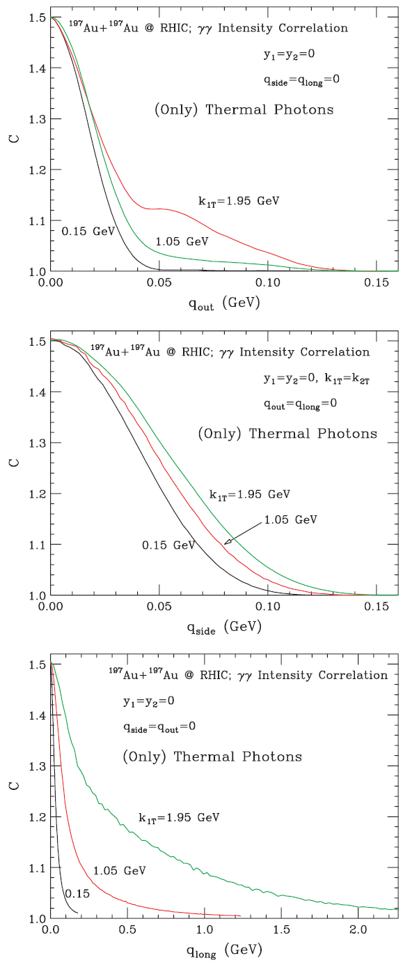
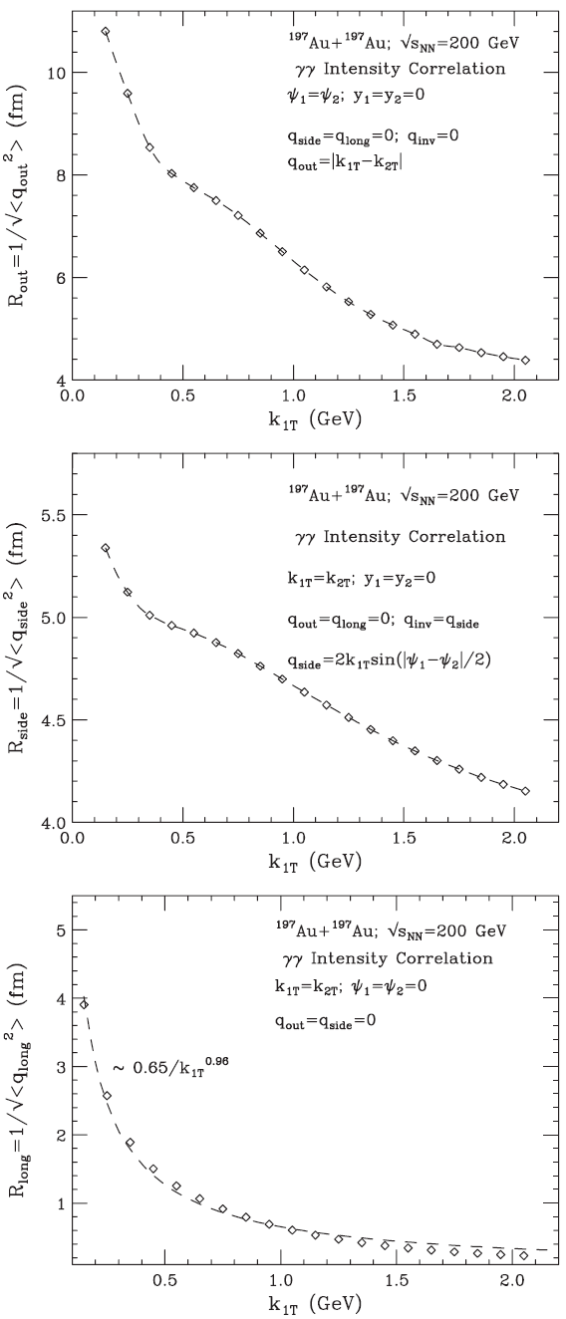
200A GeV Au+Au@RHIC
γγ intensity correlation
C(q_{out,}q_{side}=q_{long}=0)
R_{out} (K_{1T})
q_{side}=q_{long}=0
C(q_{side,}q_{out}=q_{long}=0)
R_{side} (K_{1T})
q_{out}=q_{long}=0
C(q_{long,}q_{out}=q_{side}=0)
R_{long} (K_{1T})
q_{out}=q_{side}=0
DKS, PRC 71 (2005) 034905.

Slide 13
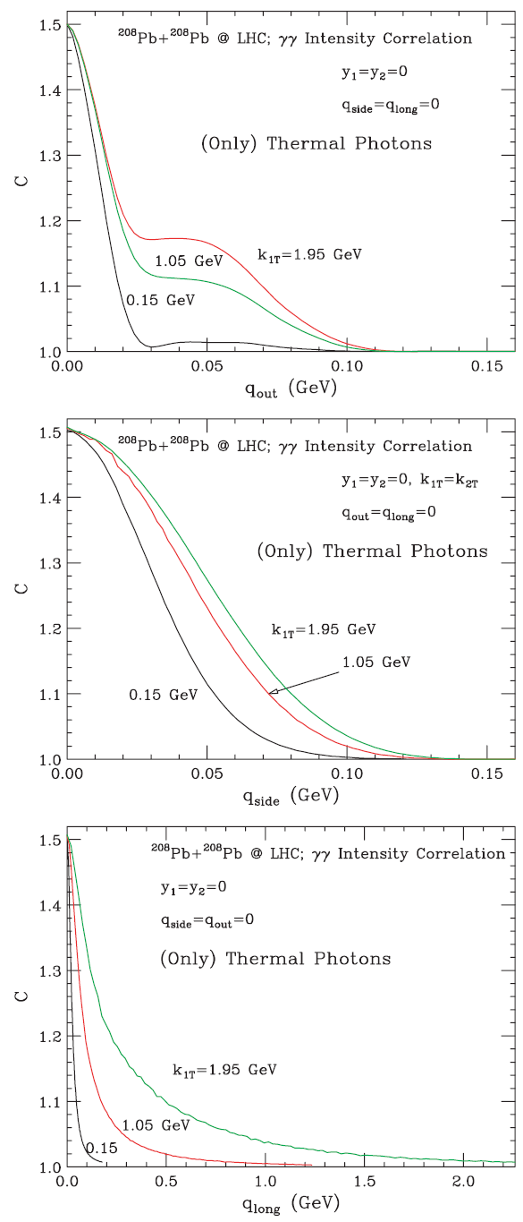
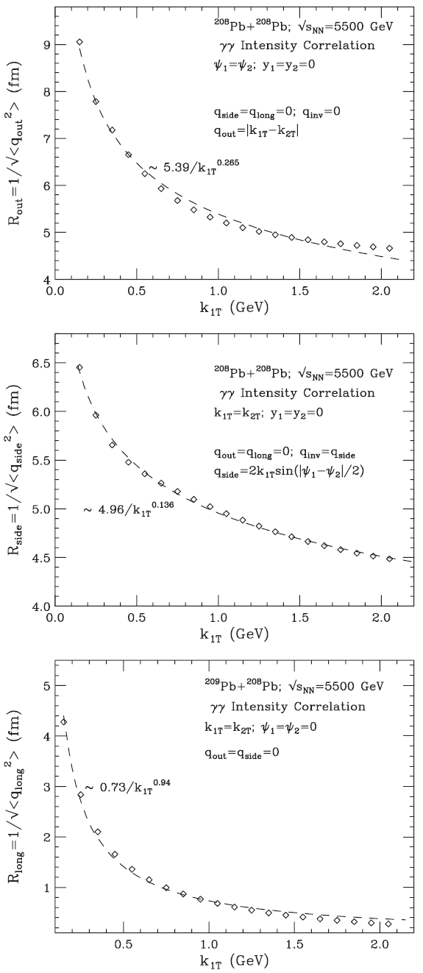
5.5A TeV Pb+Pb@LHC
γγ intensity correlation
C(q_{out,}q_{side}=q_{long}=0)
R_{out} (K_{1T})
q_{side}=q_{long}=0
C(q_{side,}q_{out}=q_{long}=0)
R_{side} (K_{1T})
q_{out}=q_{long}=0
C(q_{long,}q_{out}=q_{side}=0)
R_{long} (K_{1T})
q_{out}=q_{side}=0
DKS, PRC 71 (2005) 034905.

Slide 14
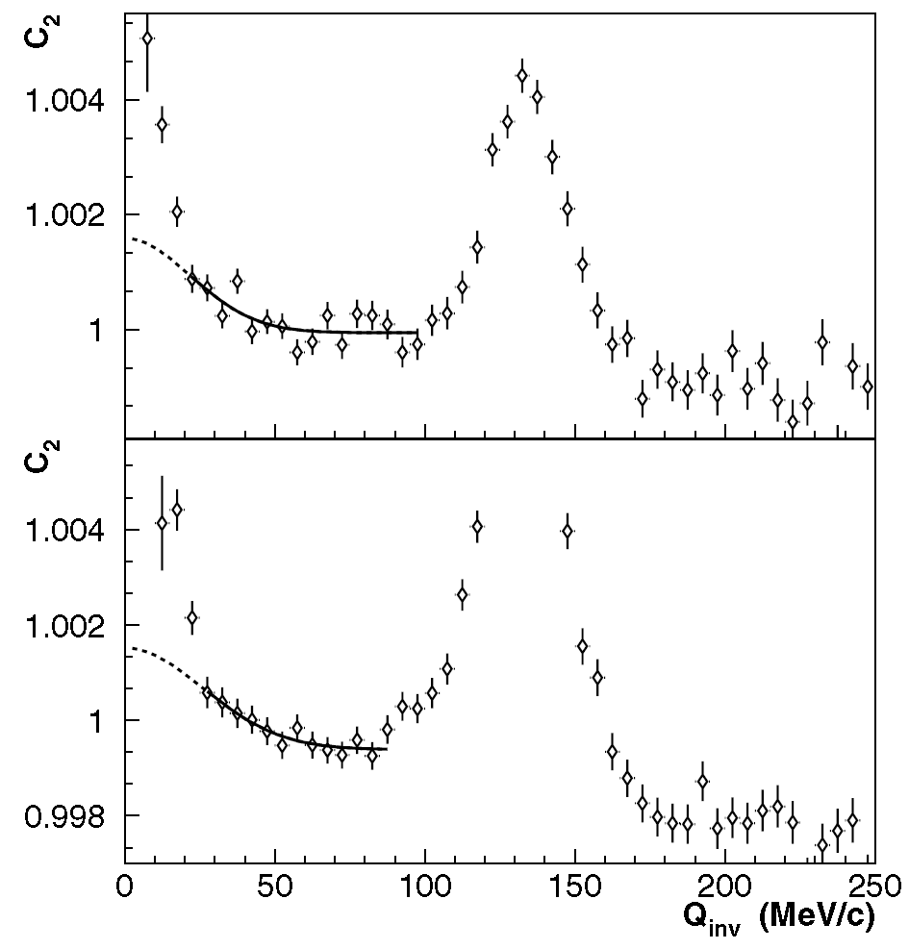
The two-photon correlation function for average photon momenta 100 < K_{T} < 200 MeV/c (top) and 200 < K_{T} < 300 MeV/c (bottom). The solid line shows the fit result in the fit region used (excluding the π⁰ peak at Q_{inv} ≈ m_{π0} ) and the dotted line shows the extrapolation into the low Q_{inv} region where backgrounds are large.
M. M. Aggarwal et al., [WA98 collaboration] PRL 93, 022301 (2004)

Slide 15
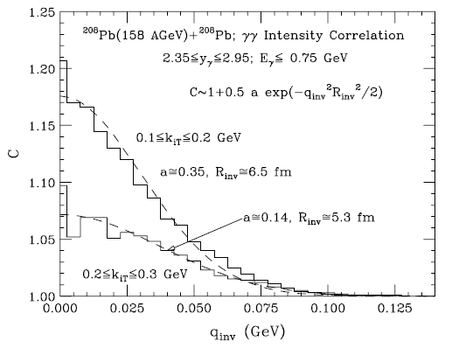
Intensity Interferometry of Thermal Photons @SPS
A one-dimensional analysis of the correlation function
C is performed in terms of the invariant momentum difference as follows:
WA98 measures R_{inv} as 8.34 ± 1.7 fm and 8.63 ± 2.0 fm, respectively
For y₁=y₂=0 and ψ₁=ψ₂=0, q_{side}=q_{long}=q_{inv}=0,
but q_{out}=k_{1T}-k_{2T} .ne.0
DKS, PRC 71 (2005) 034905.

Slide 16
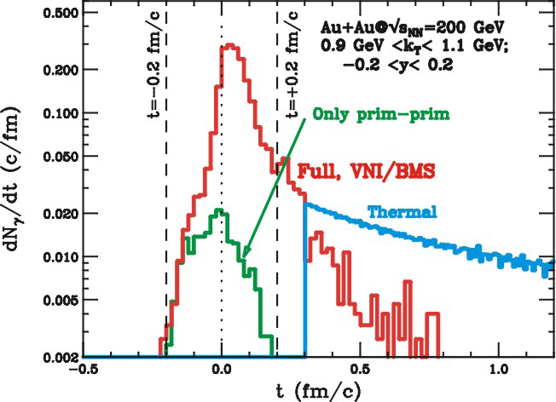
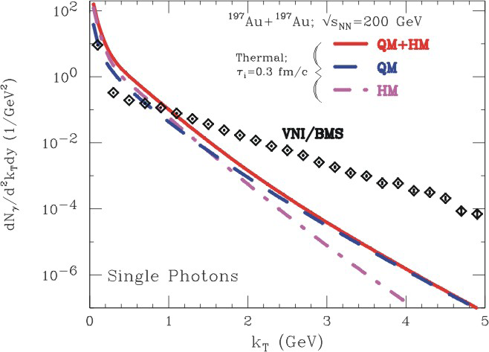
pre-equilibrium contributions are easier identified at large p_{T}.
window of opportunity above p_{T} = 2 GeV.
at 1 GeV, need to take thermal contributions into account.
short emission time in the PCM, 90% of photons before 0.3 fm/c
hydrodynamic calculation with τ₀=0.3 fm/c allows for a smooth continuation of emission rate
Bass, Mueller, & DKS, PRL 93 (2004) 16230

Slide 17
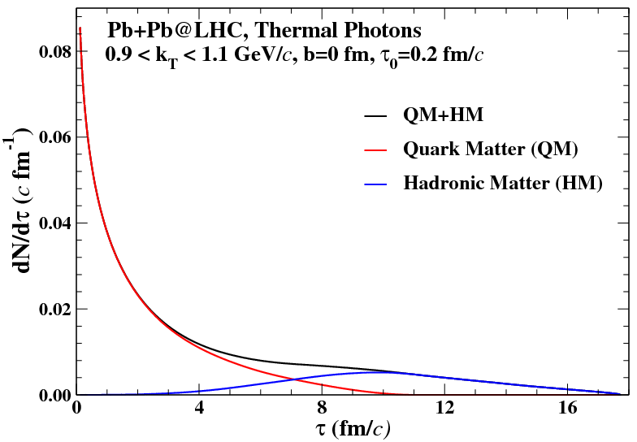

Slide 18
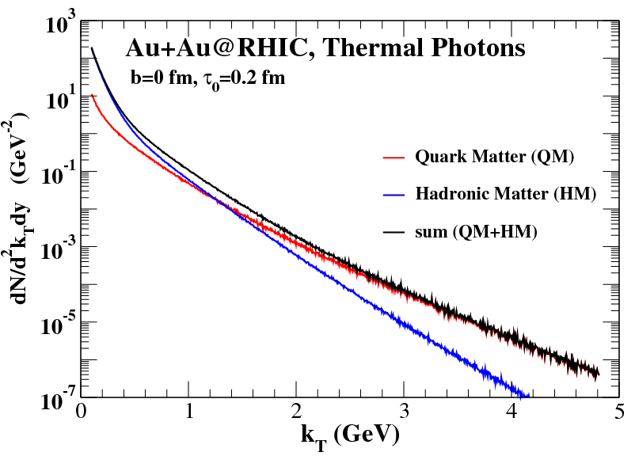

Slide 19
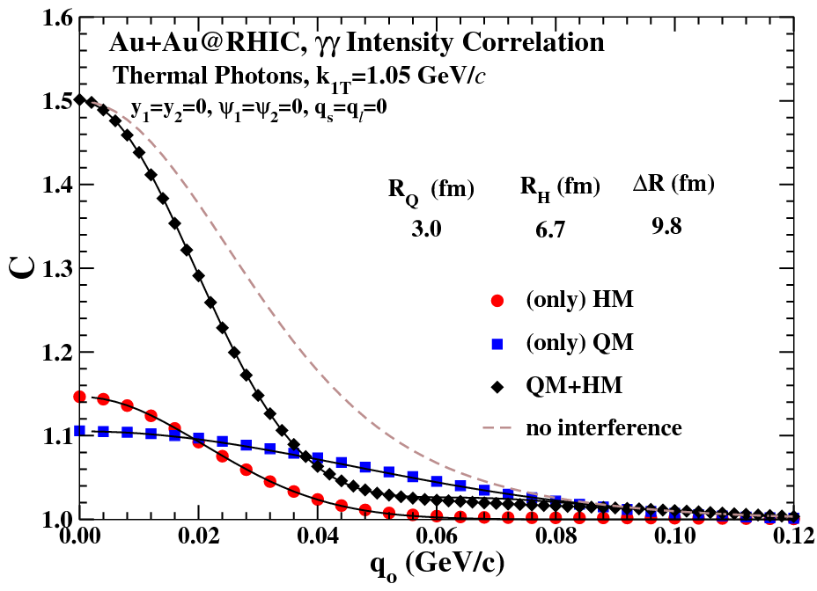
Outward correlation function of thermal photons
for 200A GeV Au+Au collision at RHIC

Slide 20
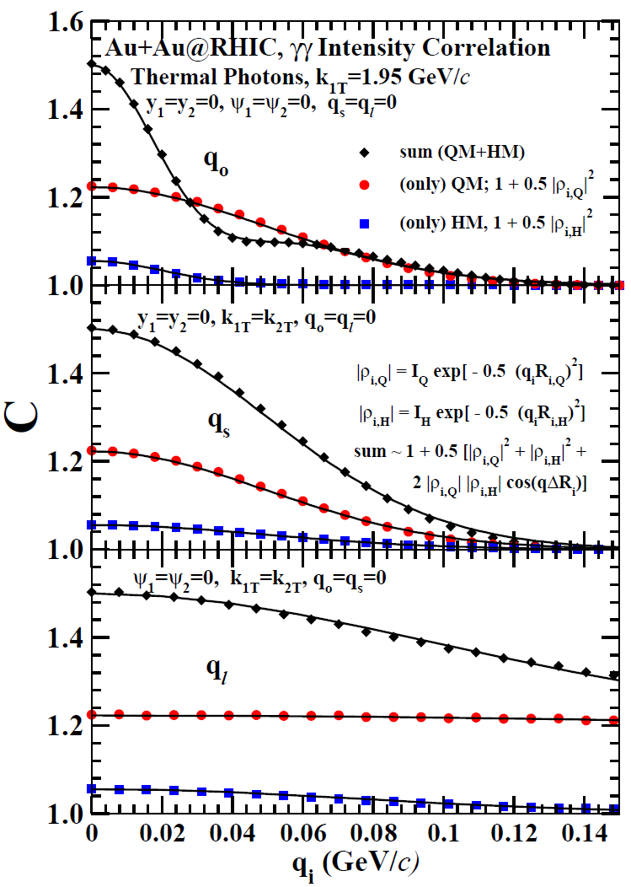
The outward, sideward, and longitudinal correlation functions for thermal photons produced in central collision of gold nuclei at RHIC taking τ₀ = 0.2 fm/c. Symbols denote the results of the calculation, while the curves denote the fits.
Correlation function in the two
phases can be approximated as
where,
i=out, side, and long
α= quark matter (Q) or hadronic matter (H)
DKS and R. Chatterjee; arXiv: 0907.1360

Slide 21
i=out, side, and long
α= quark matter (Q) or hadronic matter (H)
The final correlation function
can be approximated as:
ΔR_{i} stands for the space-time
separation of the two sources.
R_{o,Q} = 2.8, R_{o,H} = 7.0, ΔR_{o} =12.3,
R_{s,Q} ≈ R_{s,H} = 2.8, ΔR_{s} ≈ 0.,
R_{ℓ,Q} = 0.3, R_{ℓ,H} = 1.8, ΔR_{ℓ} ≈ 0.
(all values are in fm.)
DKS and R. Chatterjee; arXiv: 0907.1360

Slide 22
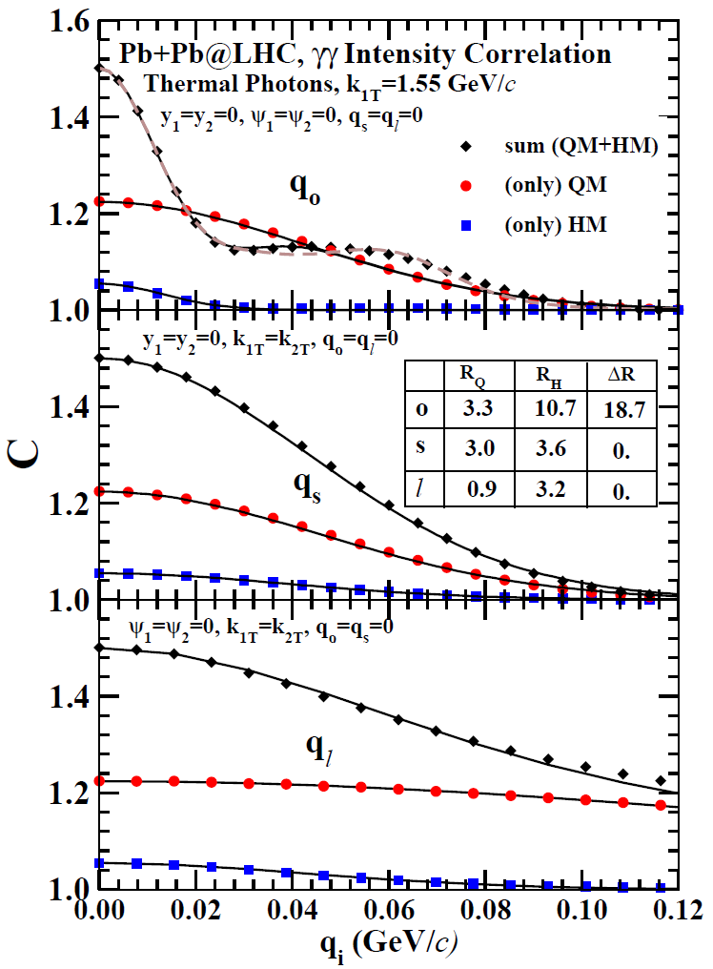
The outward, sideward, and longitudinal correlation functions for thermal photons produced in central collision of lead nuclei at LHC taking τ₀ = 0.2 fm/c. Symbols denote the results of the calculation, while the curves denote the fits.
DKS and R. Chatterjee
arXiv: 0907.1360

Slide 23
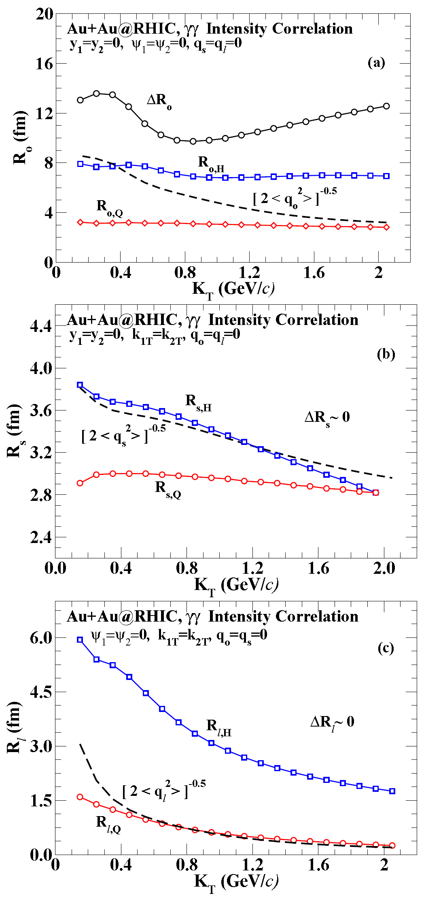
RHIC

Slide 24
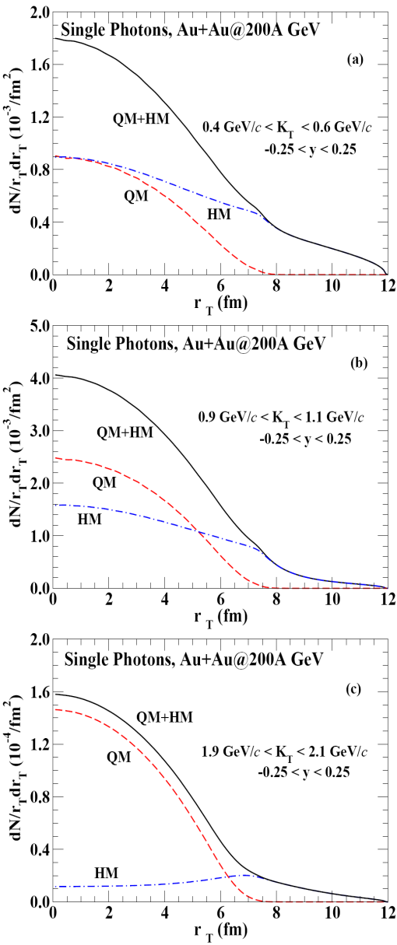
RHIC

Slide 25
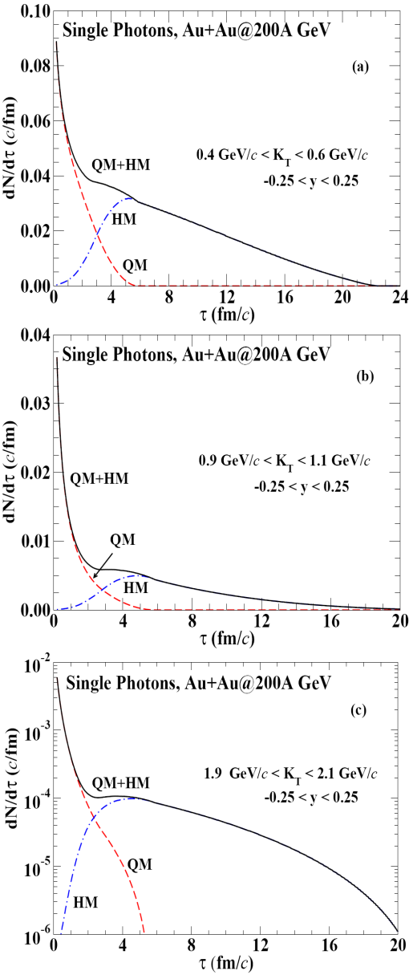
RHIC

Slide 26
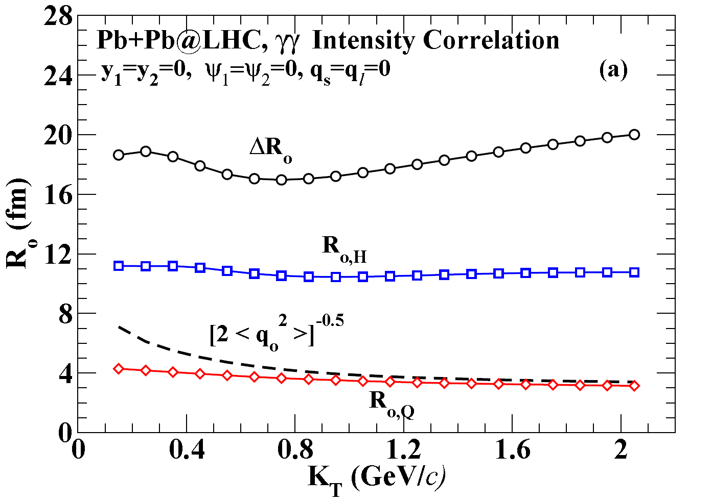
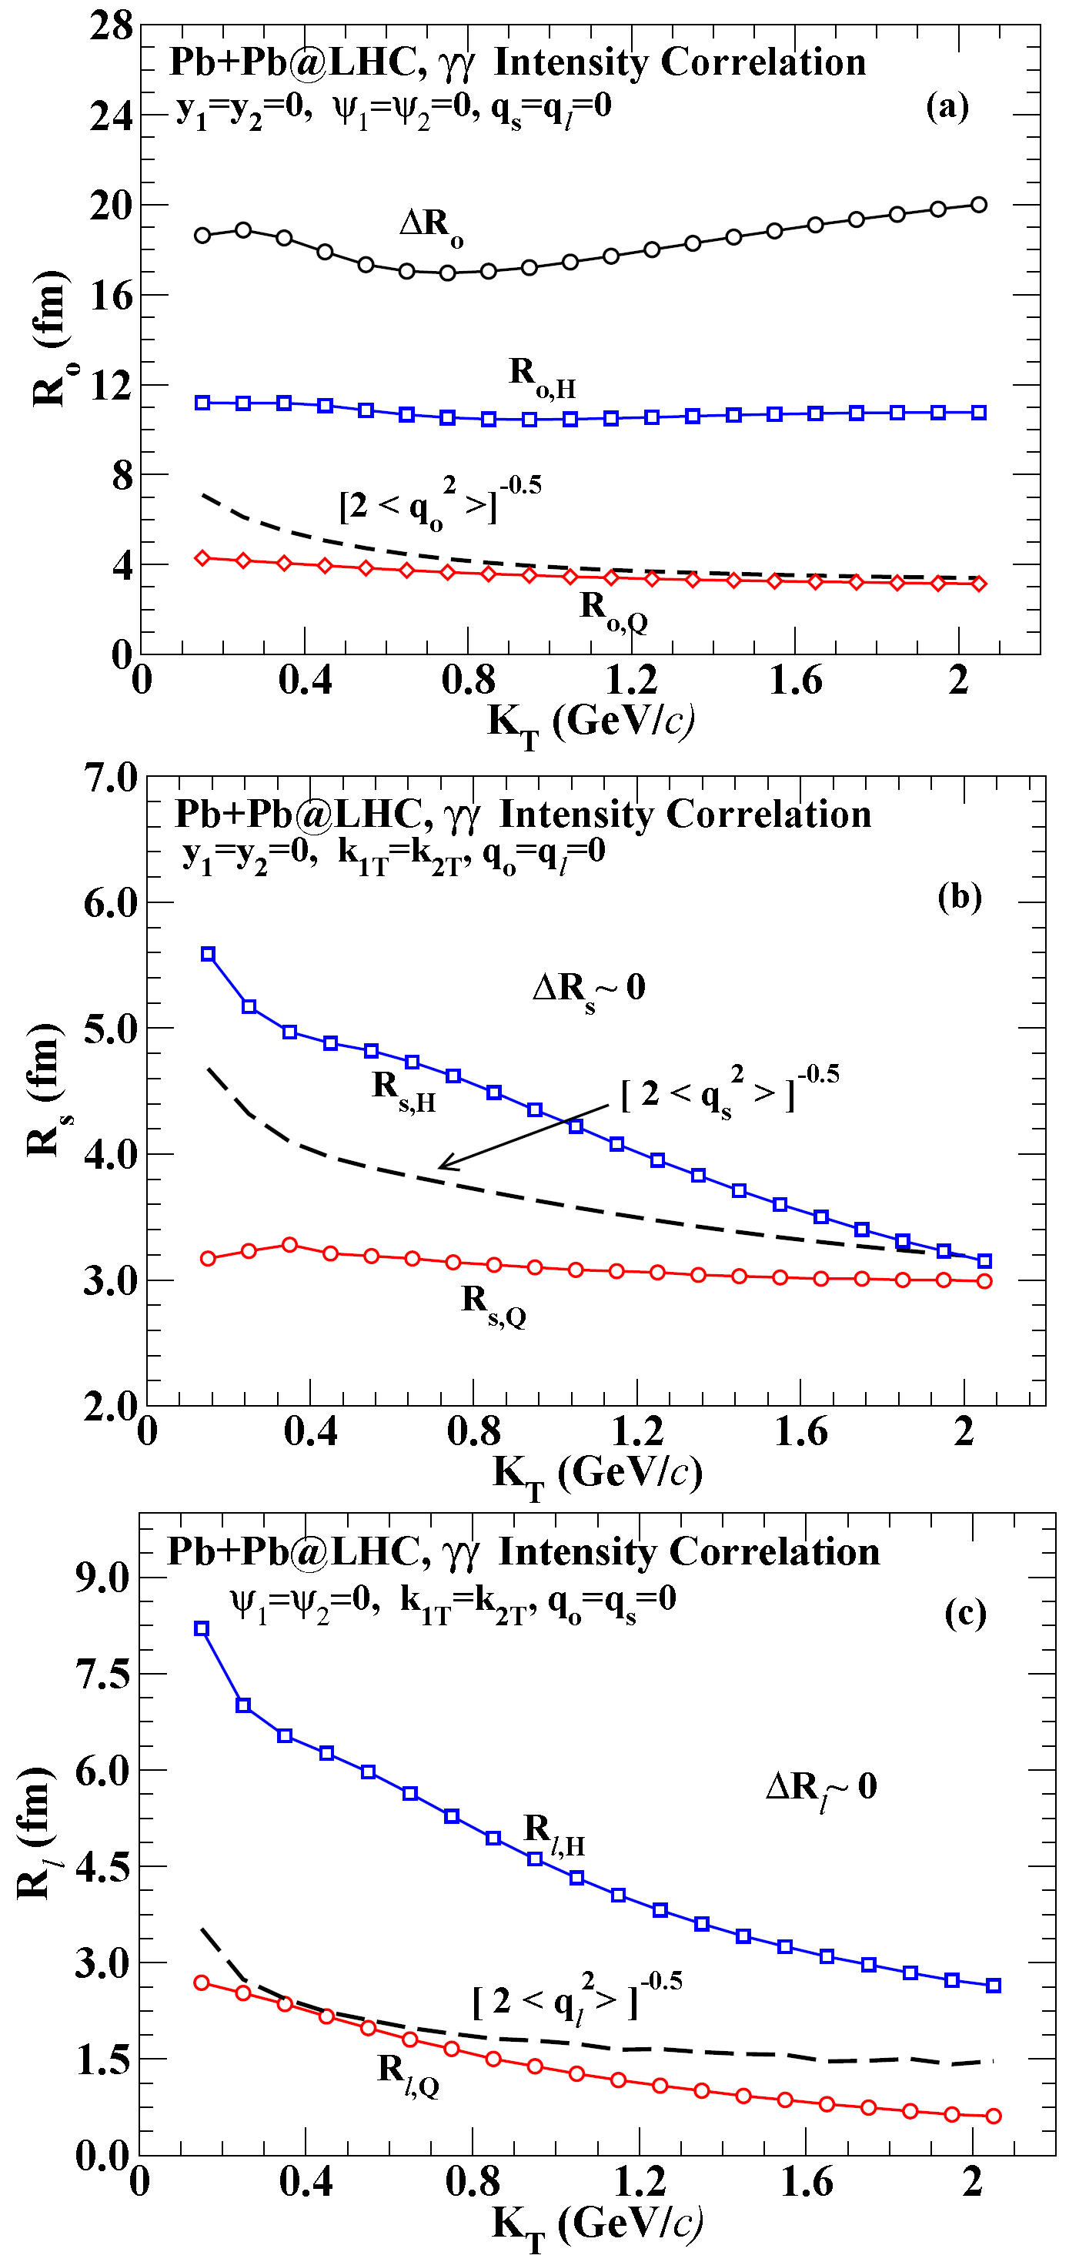
LHC

Slide 27
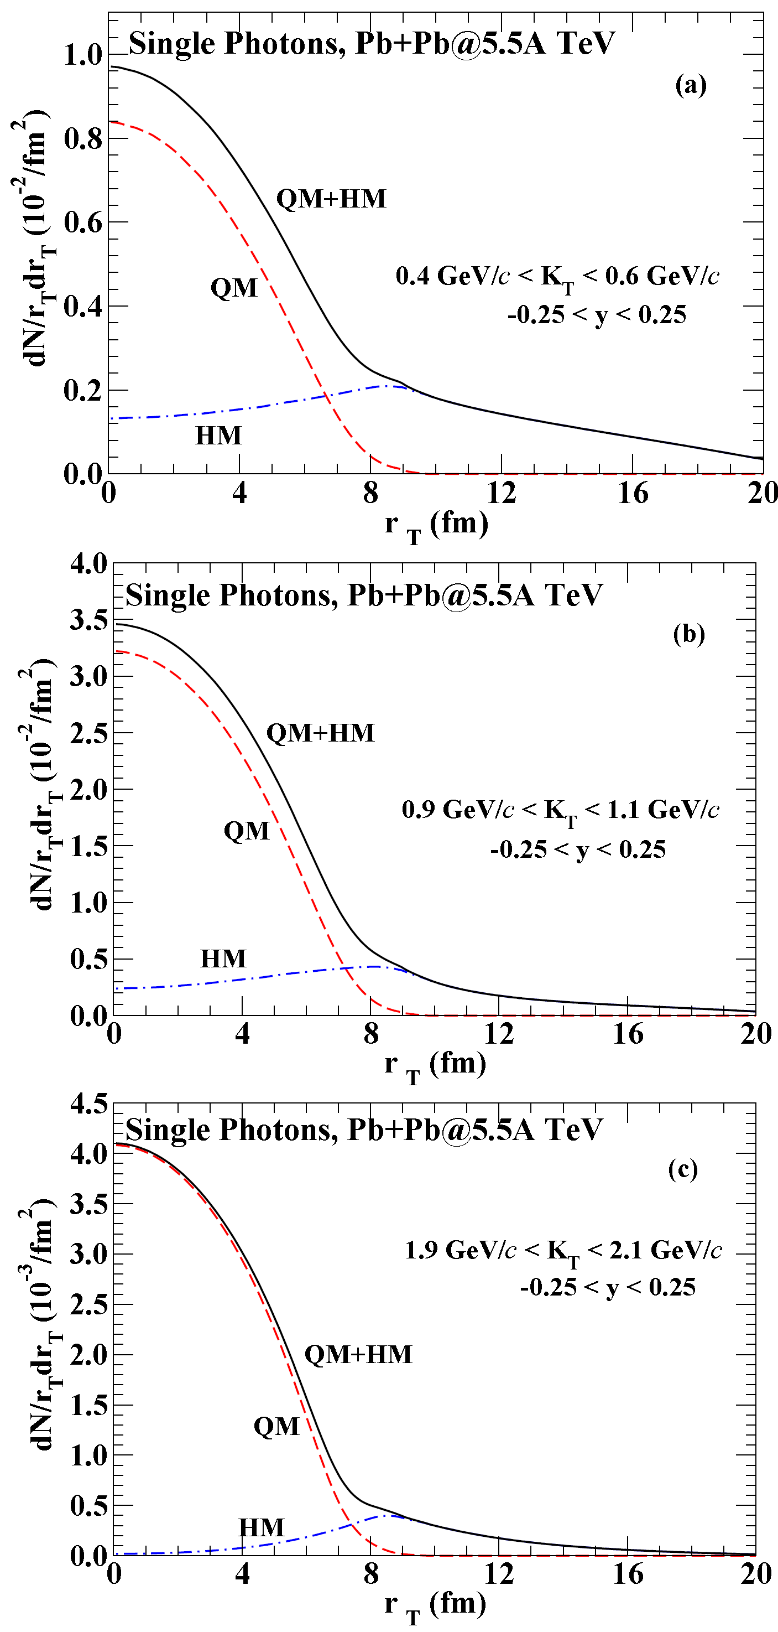
LHC

Slide 28
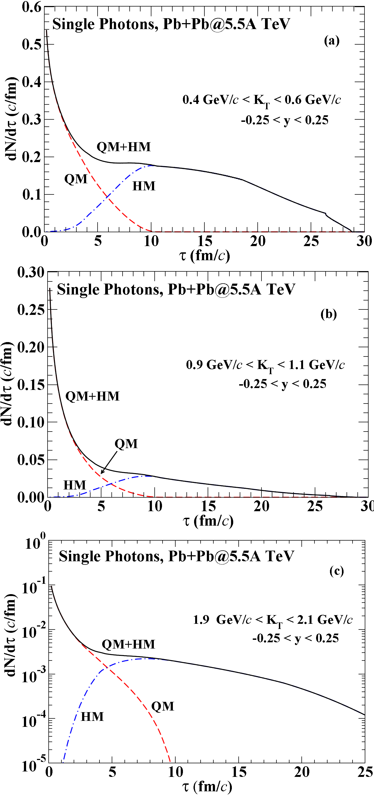
LHC

Slide 29
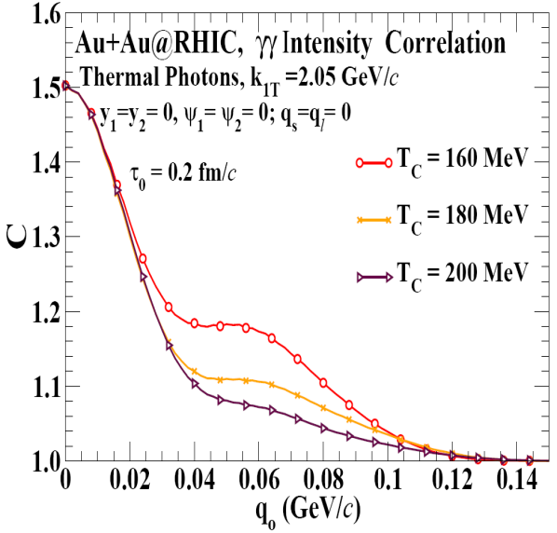
T_{C} dependence of the outward correlation function @RHIC

Slide 30
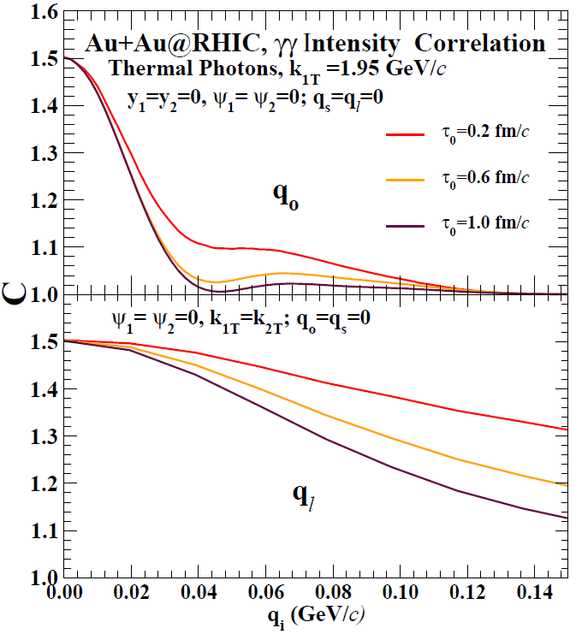
τ₀ dependence of the outward and longitudinal correlation functions at RHIC.
DKS and R. Chatterjee,
Phys. Rev. C 80, 054914 (2009)
The side-ward
correlation is
only marginally
affected and is
not shown.

Slide 31
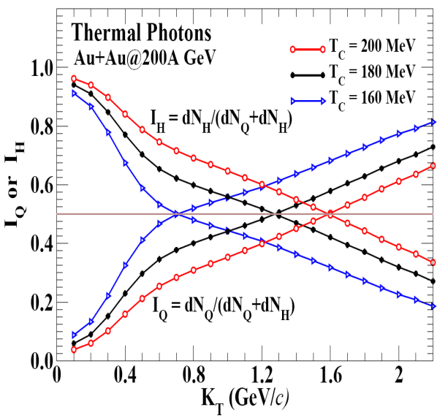
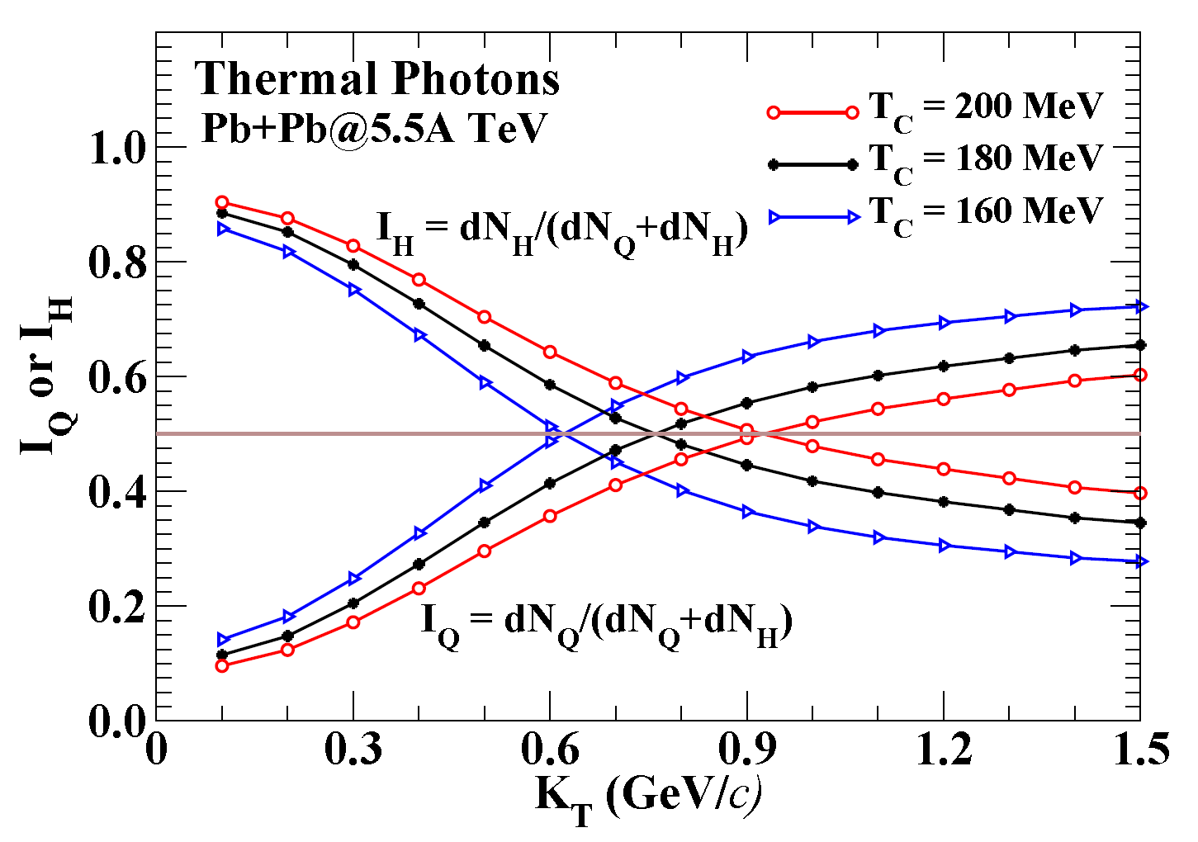
Transverse momentum dependence of fraction of thermal photons from quark matter (I_{Q}) and hadronic matter (I_{H}) at RHIC and LHC energy.

Slide 32
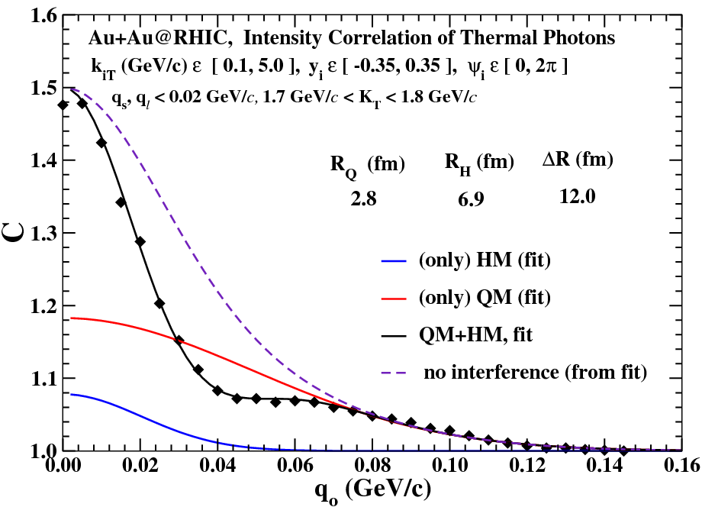
Monte Carlo calculation of intensity correlation

Slide 33
Future directions
q_{long} 
q_{side}
q_{out}
reaction
plane
Φ = 90°
R_{side} (small)‏
R_{side} (large)‏
Φ = 0°
E. Frodermann & U. Heinz; arXiv: 0907.1292

Slide 34
Elliptic Flow of Thermal Photons:
Measure Evolution of Flow !
Adult life
Late times
Early times
Chatterjee, Frodermann, Heinz, and DKS,
PRL 96 (2006) 202302.

Slide 35
Summary and Conclusions
Hadron intensity interferometry is sensitive only to the last moments of the collision dynamics.
Photons are emitted throughout the evolution of the system.
In relativistic heavy ion collisions, we have photons from quark matter and hadronic matter.
We report the first ever prediction of interference between thermal photons from quark matter and the hadronic matter.
If measured, this will give size of the system in the quark phase and the hadronic phase, relative contributions from the two phases and the life-time of the emitting source.
Similar results are expected at 40-60 MeV/A at the superconducting cyclotron energies.
Simultaneous measurements of elliptic flow and the angle dependent interferometry would be very valuable.

Slide 36

Thank you

Slide 37
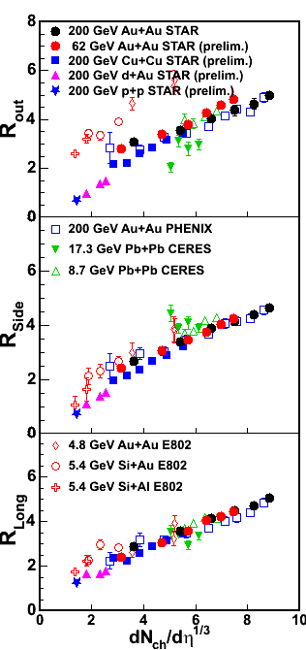
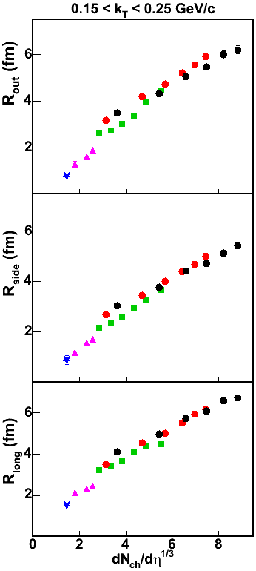
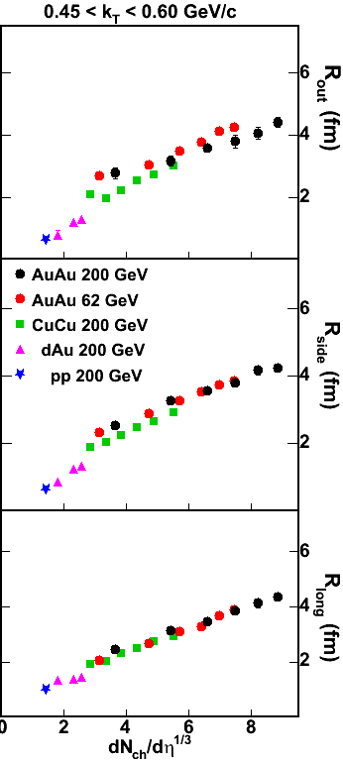
Typical results for pion intensity interferometry
RHIC/AGS/SPS Systematics
STAR DATA
(pp,dAu,CuCu,AuAu@62GeV - prelim.)
Pion HBT radii from different systems and at different energies scale with
(dN_{ch}/dη)^{1/3}
<k_{T}>≈ 400 MeV (RHIC) <k_{T}>≈ 390 MeV (SPS)
Lisa, Pratt, Soltz, Wiedemann, nucl-ex/0505014
Notes:
Forget A,B,√s, Npart...
dN/dη determines all radii,
at all mT (!!!!)
is it „trivial” ?

Slide 38
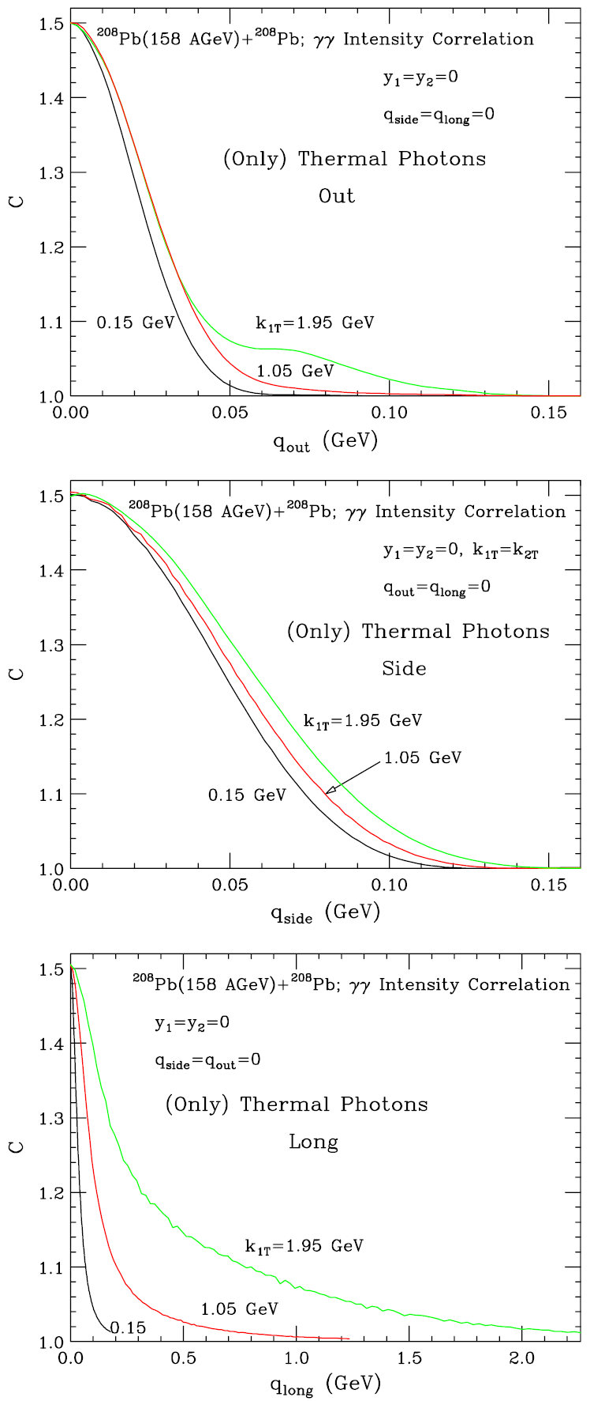
The outward, sideward, longitudinal correlation
function for thermal
photons produced in central collision of Pb nuclei at CERN
SPS.
DKS, PRC 71 (2005) 034905.

Slide 39
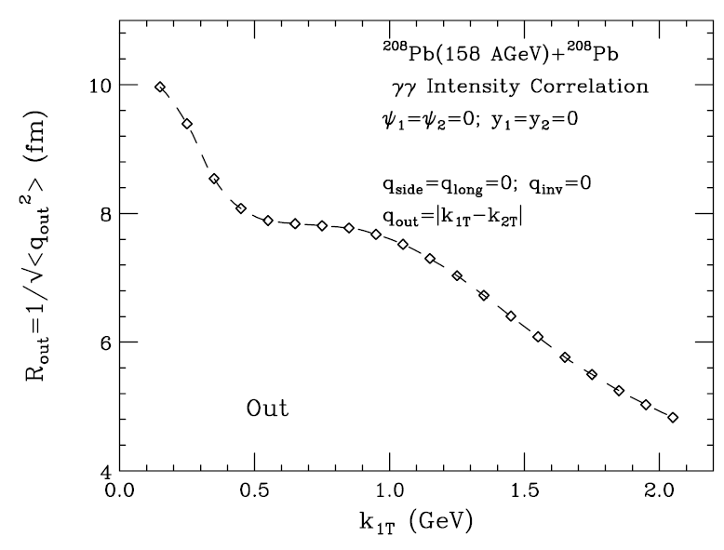
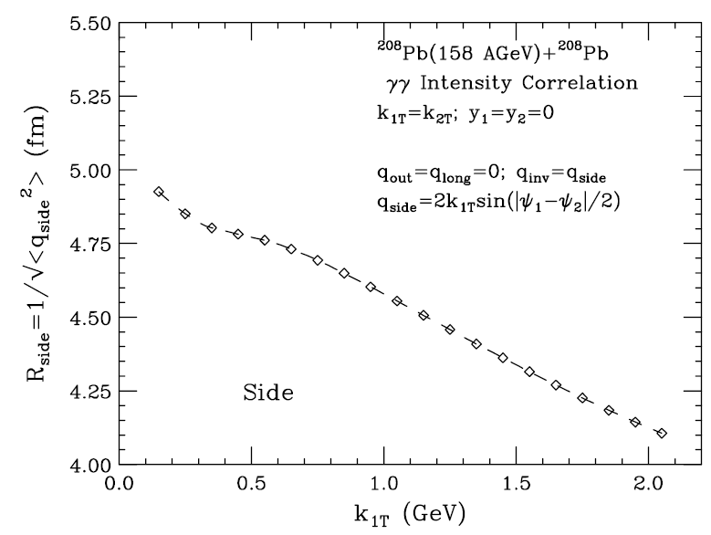
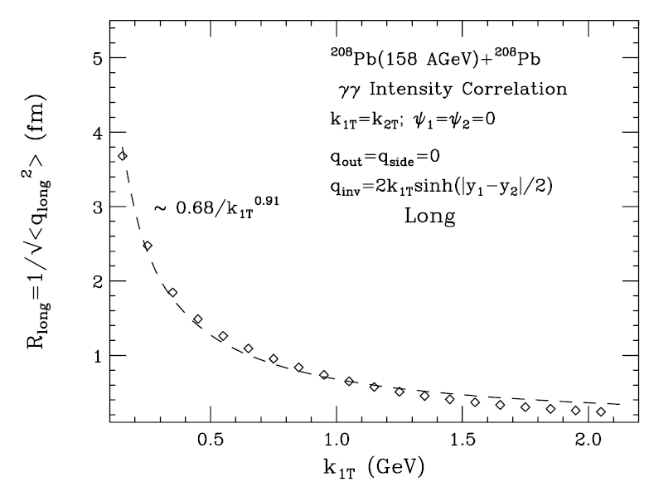
The outward, sideward, longitudinal radii for thermal photons produced in central collision of Pb nuclei
at CERN SPS.
DKS, PRC 71 (2005) 034905.

Slide 40
Emission amplitude
phase of source
bosons / fermions
real function, characterizes the source strength
Single particle distribution function
x₁-x₂
Incoherent emission
⇒
⇒

Slide 41
r₁
k₁
x₁
Quantum statistical correlation
ΔR
r₂
k₂
x₂
Two particle emission amplitude
Two particle distribution function
k₁-k₂
⇒
Correlation function
If instead of two discrete sources, one has a distribution of sources, ρ(x ), then averaging over the distribution, one finds that the correlation function measures the Fourier transform of the source distribution:

Slide 42
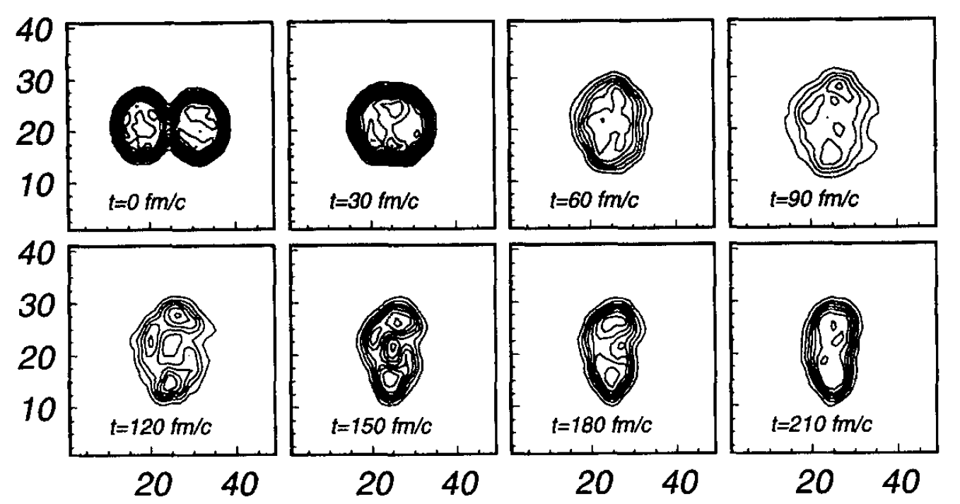
x (fm) →
z (fm) →
Spatial evolution of a central collision in the nucleus-nucleus centre of mass frame obtained with BUU calculation for the system ¹⁸¹Ta+¹⁹⁷Au at 40A MeV.

Slide 43
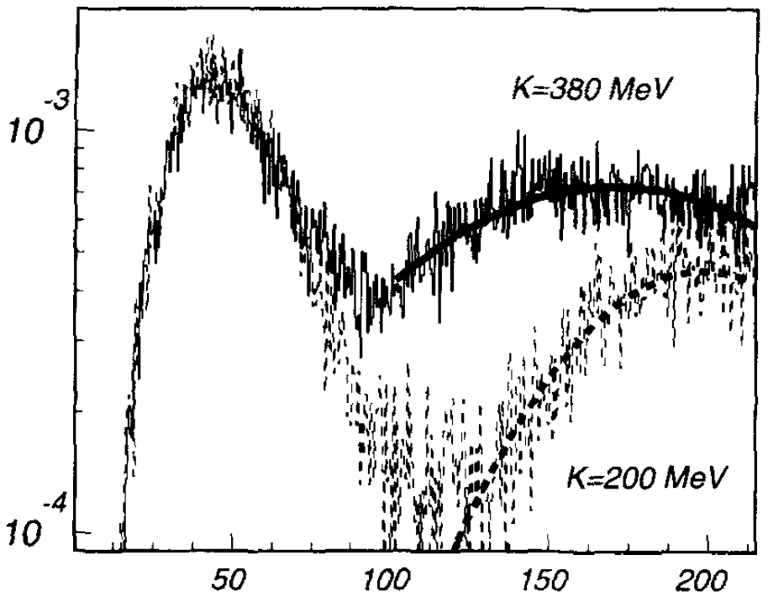
γ production rate (a.u.) →
Time (fm/c) →
Production rate of photons with an energy of 30 MeV as a function of the incompressibility K∞ of nuclear matter obtained with BUU calculations for the system ¹⁸¹Ta+¹⁹⁷Au at 40A MeV and b= 5 fm.

Slide 44
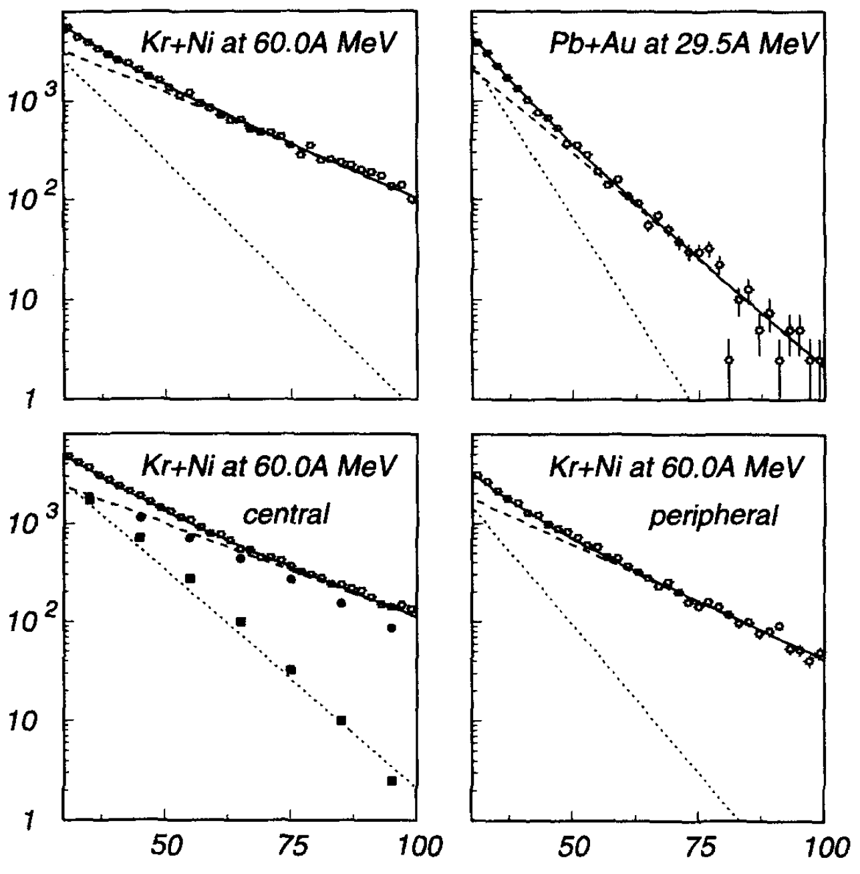
Inclusive hard photons at θ_{lab}=90⁰. Thermal (solid squares) and direct (sold circles).
(counts/MeV) →
E_{γ} (MeV) →
G. Martinez et al.; Physics Letters B 349, 23 (1995).

Slide 45
F. M. Marques et al., Phys. Rept. 284, 91 (1997)
Δr
ρ(r) → ρ(q)
ρ(r -Δr) → ρ(q) X e^{iqΔr}
Ι_{d} ρ(r) + Ι_{t} ρ(r -Δr) → ρ(q) X (I_{d}+I_{t} e^{iqΔr})
Intensity
I_{d}
I_{t}
r
Initial
compression
2nd compression
The correlation function
C₁₂(q) = 1 + λ exp(- q²R² - q₀²τ²) I_{γγ}(q)
I_{γγ}(q) = I_{d}² + I_{t}² + 2 I_{d} I_{t} cos(qΔr)

Slide 46
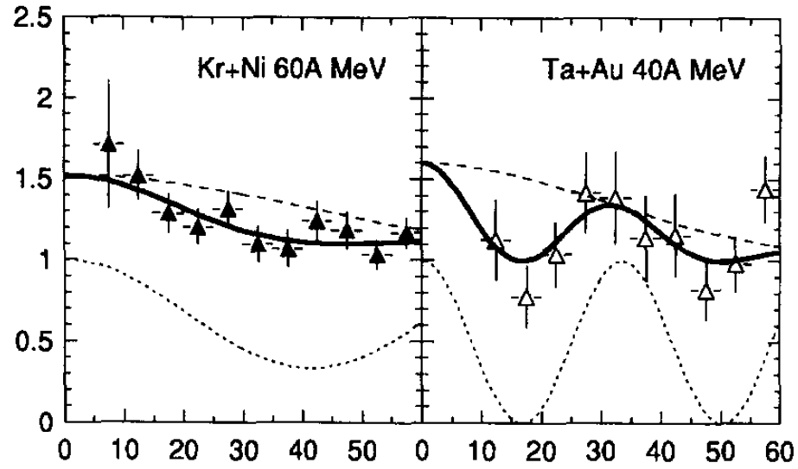
C₁₂
Q (MeV)
Fits to the interferometry data; showing interference
between two sources.

